Slide 1




INSTITUTE OF ADVANCED COMPUTING AND SOFTWARE DEVELOPEMENT,AKURDI PUNE
TITLE
“EMPLOYEE PERFORMANCE PREDICTION BASED ON THE PAST DATA”
Presented By : Gautamee Jakinkar 239519
Anuja Chavan 239509
PG-DBDA | SEPTEMBER 2023

Slide 2
PROBLEM STATEMENT:
To Build A Model To Predict Performance of Employees, Based On The Visualization and Analysis of Past Data of Employee Performance

Slide 3
OBJECTIVES:
To determine the most critical metrics that reflect employee performance based on historical data
To develop predictive models that forecast future performance trends
To develop a framework for evaluating employee performance based on past data
To Analyze past performance data to identify skills gaps and training needs among employees

Slide 4
WORKFLOW OF PROJECT:
DATA
GATHERING
DATA
CLEANING
MODEL
BUILDING
MODEL EVALUATING

Slide 5
DATA PREPROCESSING AND CLEANING:
Treat NULL Values
Remove Duplicate Data
Identify Outliers in The Dataset
Perform Feature Encoding or Transformation For Categorical Variables

Slide 6
DATA SCALING:
Scaling is a technique to standardize the independent features present in the data in a fixed range. We have used the below-mentioned Scalers:
Robust Scaler
Standard Scaler
Min-Max Scaler
MaxAbs Scaler

Slide 7
DATA MODELING:
Data modeling algorithms are techniques used to build for various purposes such as prediction, classification, clustering, regression, and recommendation. We have used the following model algorithms:
XGBoost
CATBoost
LightGBM

Slide 8
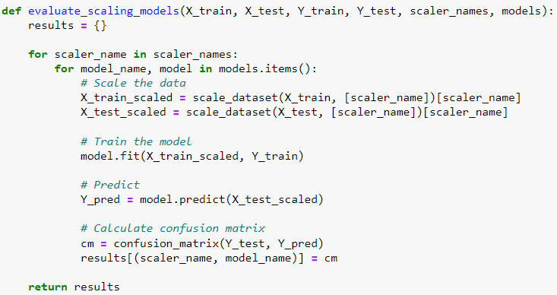
CODE:
Function To Evaluate Each Combination of Scaling Function and Model Using Confusion Matrices

Slide 9
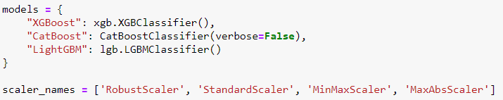

Define The Models and The Scaling Techniques
Evaluate The Models

Slide 10
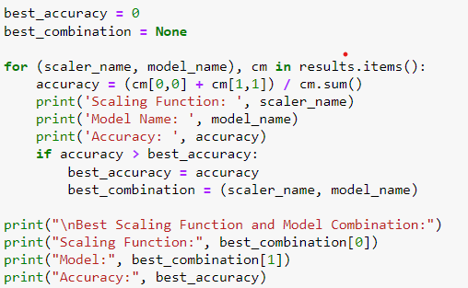
To Determine The Best Scaling Function and Model Based on Accuracy

Slide 11
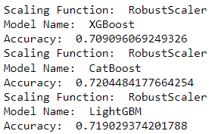
Accuracy Determined By Using Combination of Scaling Function and Model Algorithm
Robust Scaler and XGBoost/CATBoost/LightGBM

Slide 12
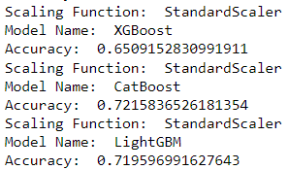
Accuracy Determined By Using Combination of Scaling Function and Model Algorithm
Standard Scaler and XGBoost/CATBoost/LightGBM

Slide 13
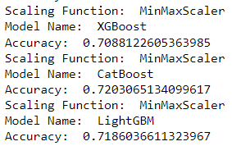
Accuracy Determined By Using Combination of Scaling Function and Model Algorithm
MinMax Scaler and XGBoost/CATBoost/LightGBM

Slide 14
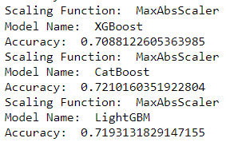
Accuracy Determined By Using Combination of Scaling Function and Model Algorithm
MaxAbs Scaler and XGBoost/CATBoost/LightGBM

Slide 15
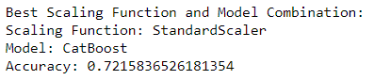
Best Combination of Scaling Function and Model Algorithm

Slide 16
CONCLUSION:
Successful implementation of a model for employee performance prediction based on past data involves a systematic approach that combines preprocessing techniques and advanced machine learning algorithms. By combining scaler functions and algorithms effectively, organizations can develop models that accurately predict employee performance.

Slide 17

THANK
YOU..!

